Slide 1








Our Journey from Struggle to Success
Creating Videos for Education
Phase 1: Gemini
Phase 2: Free Alternatives
Phase 3: MindVideo.ai
Initial attempt with limited capabilities
Exploring numerous free options
The breakthrough solution
From frustration to success: How the right tool changed everything
October 29, 2025

Slide 2












Project Background
The Goal
Enhance the multiple choice program with high-quality, engaging educational videos to present questions and explanations in a more vivid way.
"Our goal was to create high-quality, engaging educational videos to make the multiple choice program more interactive and effective."
Anticipated Challenges
Selecting appropriate video production tools
Creating visually appealing educational content
Efficiently managing video production workflow
Page 2 of 24

Slide 3






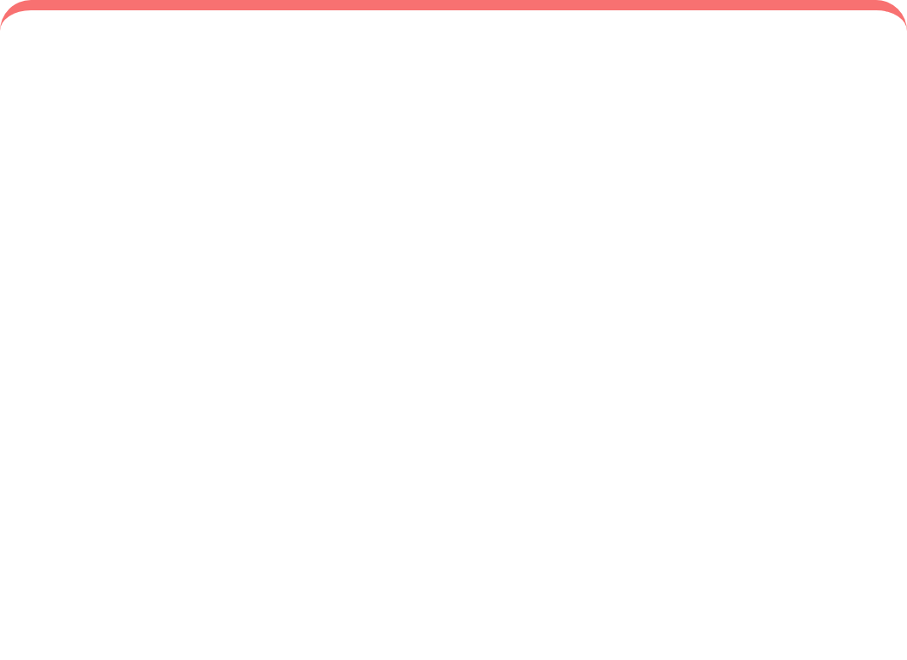











Our Three-Phase Journey
Phase 1: Gemini
Phase 2: Free Tools
Phase 3: MindVideo.ai
Initial hope in Google's AI model
Extensive search for cost-effective solutions
Discovered AI-powered video creation platform
Discovered significant video generation limitations
Watermark issues on generated videos
Intuitive interface and powerful features
Rate limits and lack of user-friendly interface
Functionality restrictions and poor UX
Successfully created engaging educational videos
Page 3 of 24

Slide 4















Phase 1: The Gemini Attempt
Why We Chose Gemini
Advanced AI model from Google with strong text and image processing capabilities
Expected to provide cutting-edge video generation functionality
Google Gemini
Believed Gemini's intelligence would allow efficient conversion of text to visual content
Our Initial Choice
Initial Approach
Gemini Processing
We developed a workflow that leveraged Gemini's text and image capabilities, hoping it would serve as a comprehensive video production solution.
Text Input
Video Output
Page 4 of 24

Slide 5












Limitations of Gemini
Key Limitations
Capability Gap
Text & Image Focus
Primarily focused on text output and multimodal generation (images), not video production
Gemini Capabilities
Our Requirements
Text generation
Video coherence
Image generation
Dynamic effects
No Direct Video Interface
Multimodal outputs
Specific formats
Lacks a direct, user-friendly video generation interface or feature
Key Insight
Despite its advanced capabilities, Gemini is not an end-to-end video production solution. It cannot generate videos directly from text prompts with the required coherence, dynamic effects, and format control.
Rate Limitations
API constraints: 3 requests/minute, 10,000 tokens/minute, 15 requests/day for Gemini 2.5 Flash
Page 5 of 24

Slide 6














Technical Constraints with Gemini
API Rate Limitations
Gemini's API has severe rate restrictions that limit video generation attempts:
3 requests per minute
10,000 tokens per minute
15 requests per day
No Direct Video Generation
No End-to-End Solution
Gemini lacks a direct, user-friendly video generation interface or functionality for non-professional users.
Gemini does not provide an integrated platform for combining script, visual elements, voiceover, and subtitles.
"Despite its capabilities in text and image processing, Gemini proved inadequate for our video creation needs."
Page 6 of 24

Slide 7





















Phase 2: Exploring Free Alternatives
The Pivot
After encountering limitations with Gemini, our team strategically pivoted to explore free online video creation websites as a potential cost-effective solution.
The Approach
Extensive research across numerous free platforms
Gemini
Research
Evaluation
Frustration
Significant time investment in exploration
Systematic evaluation of tool capabilities
Tool 1
Tool 2
Tool 3
"Despite our diligent efforts, this phase revealed common limitations across most free video creation tools, leading to growing frustration."
Page 7 of 24

Slide 8


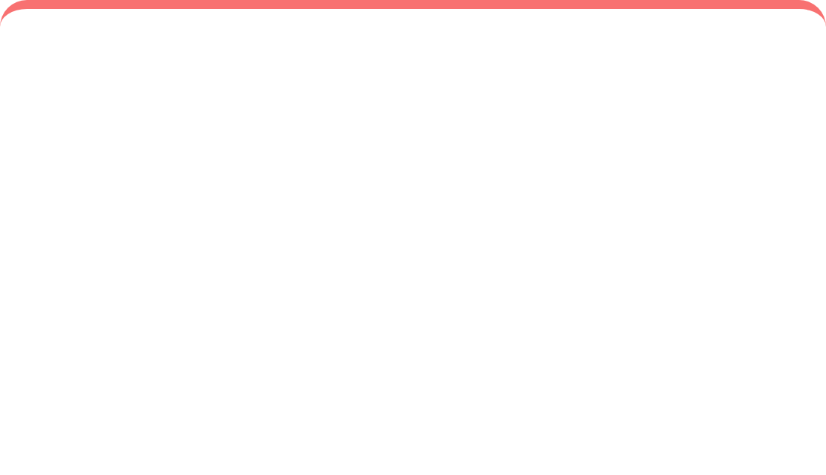

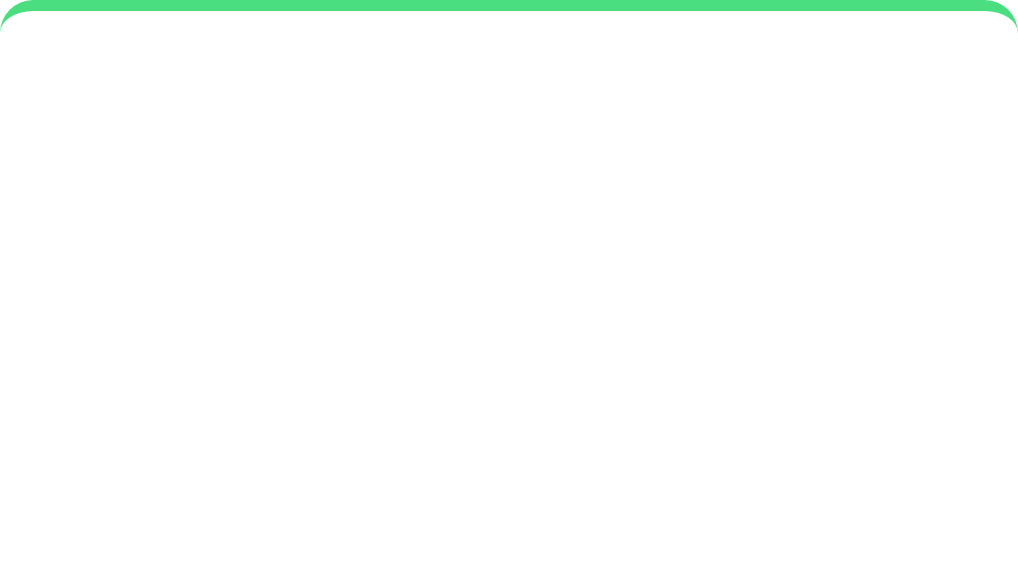






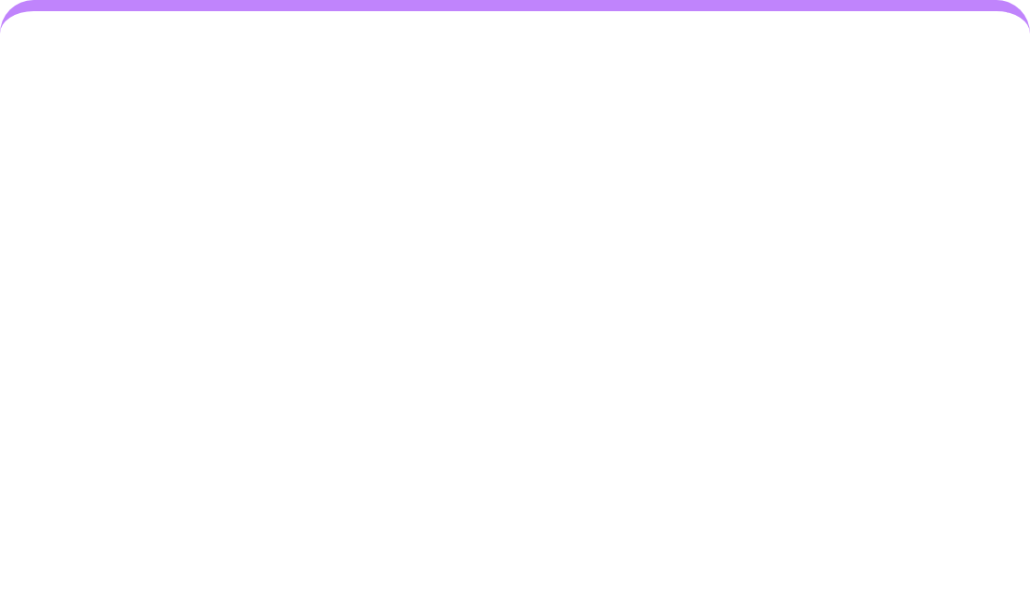
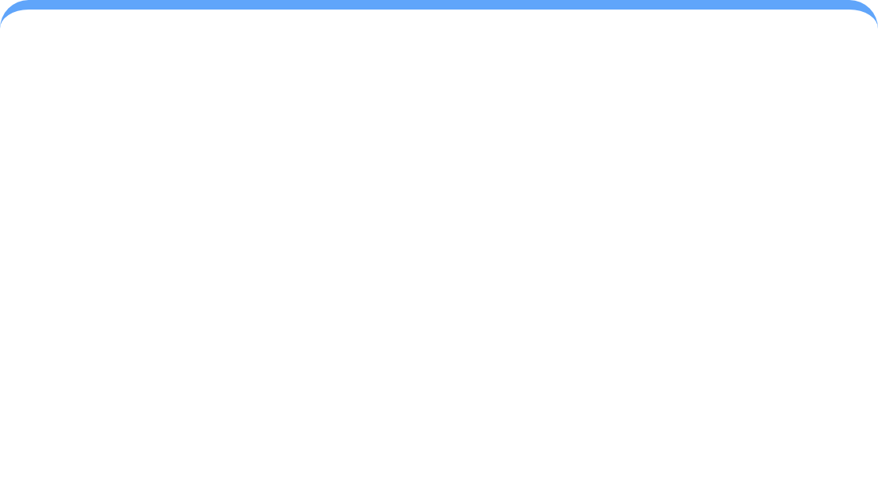
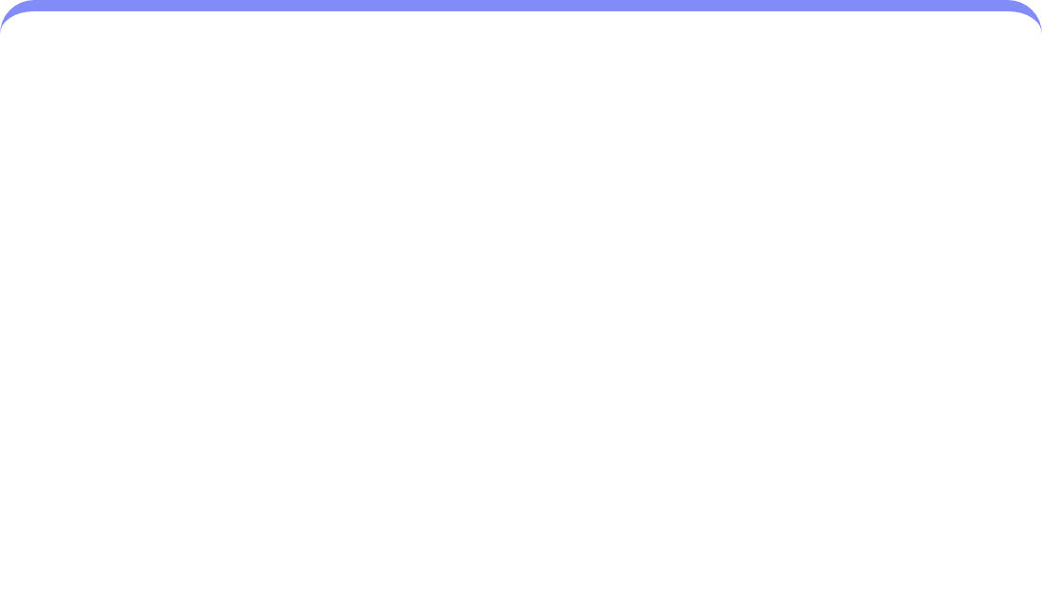






Common Limitations of Free Tools
After extensive exploration, we found that free video creation platforms shared common limitations that hindered our project:
Functionality Restrictions
Obtrusive Watermarks
Inconsistent Performance
Free tools imposed severe limitations on video length, resolution, and available features, making it difficult to produce comprehensive educational content.
Many free platforms embedded prominent watermarks on generated videos, which was unacceptable for professional educational materials.
The reliability of these free services varied, leading to unstable performance, frequent crashes, or slow processing times.
Steep Learning Curves
Limited Customization
Video Length Restrictions
Some tools suffered from complex interfaces or unintuitive user experiences, requiring significant time investment to master.
The ability to customize visuals, audio, or integrate specific branding elements was often severely restricted.
Many platforms limited the maximum video length, preventing us from creating longer educational content.
Page 8 of 24

Slide 9













Watermark Problems
The Watermark Issue
Sample Video
Free video platforms often embed prominent watermarks that:
1080×720 • MP4
FREE VERSION
Compromise the professional appearance
Distrupt the viewing experience
Make videos unsuitable for educational use
Processing...
"Watermarks were one of the most significant drawbacks we encountered, as they made our educational content appear unprofessional and distracted learners."
Quality
Perception
Usage
Reduced professionalism
Lower credibility
Unsuitable for education
Page 9 of 24

Slide 10


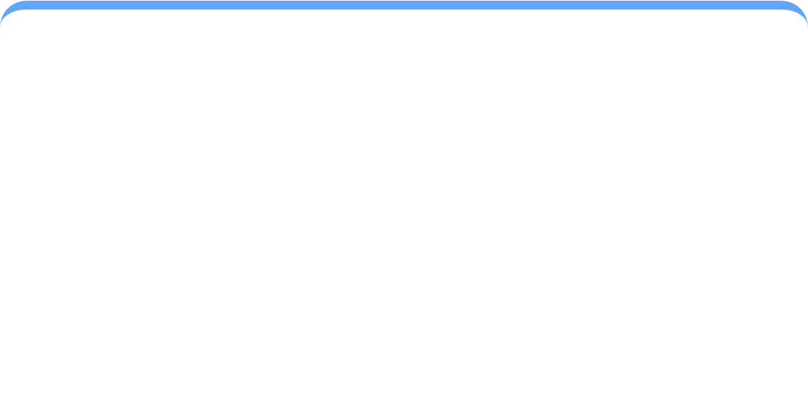










Performance and Reliability Issues
Free video creation tools exhibited significant performance and reliability issues that hampered our project:
Inconsistent Performance
Frequent Crashes
Slow Processing
Unpredictable response times
Unexpected application failures
Long waiting times
Varying quality output
Loss of unsaved work
Reduced productivity
Impact: These reliability issues caused significant delays and frustration, stalling project progress.
Page 10 of 24

Slide 11
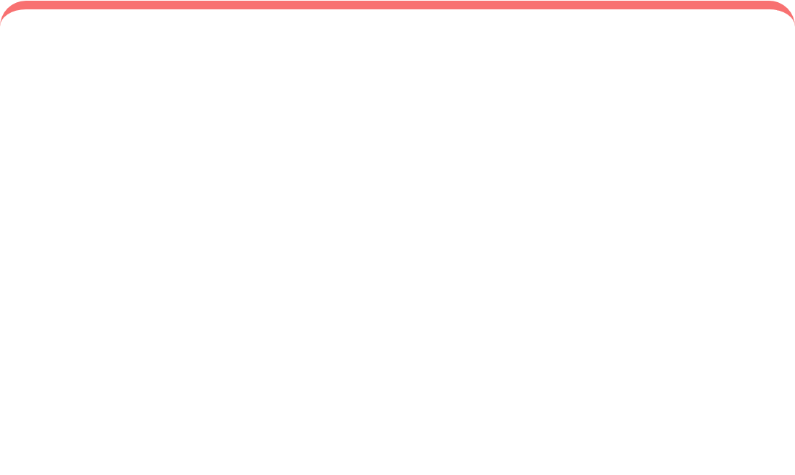






User Experience Challenges
Many free video creation tools presented significant user experience challenges that hindered our productivity:
Complex Interfaces
Steep Learning Curves
Poor UX Design
Tools with cluttered layouts and non-intuitive navigation required significant time to learn
Mastering advanced features required substantial time investment that our project couldn't afford
Unintuitive workflows and inconsistent interfaces led to confusion and errors
"The complex interfaces and steep learning curves of these free tools required significant time investment to master, causing a noticeable slowdown in project momentum and a dip in team morale."
Page 11 of 24

Slide 12


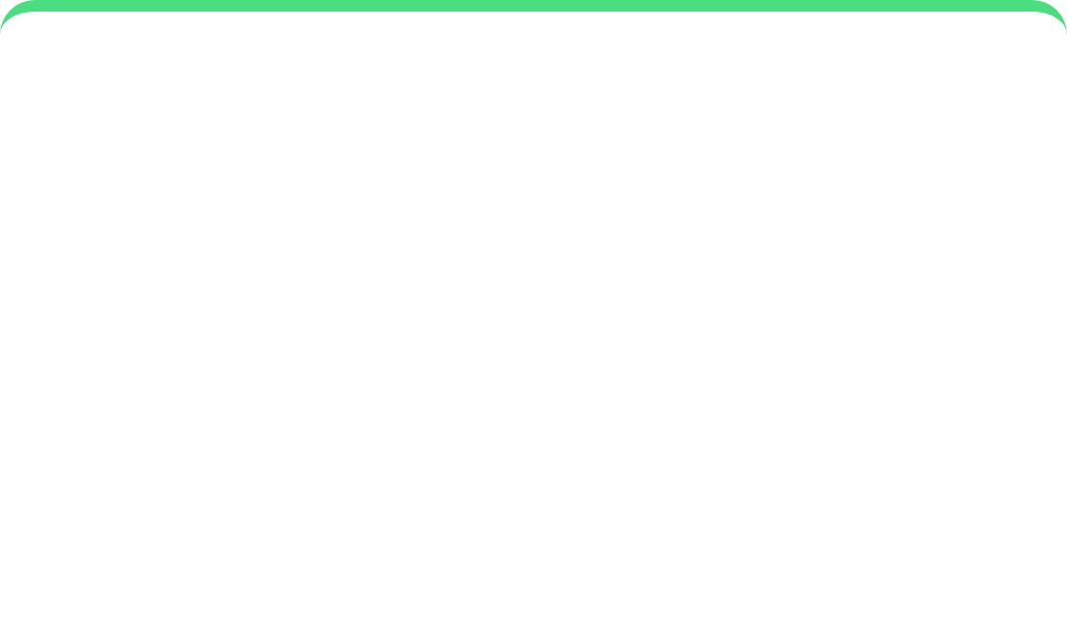



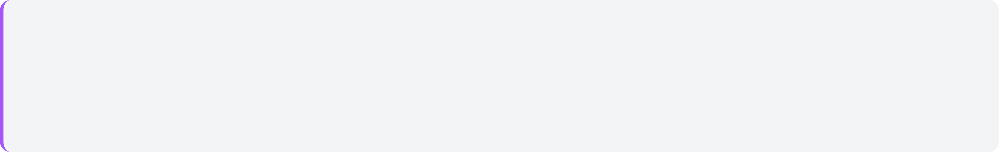





Customization Barriers
Free video tools severely limited our ability to create tailored educational content for the multiple-choice program.
Visual Limitations
Audio Constraints
Integration Issues
Restricted access to customization of visuals, preventing alignment with educational brand identity.
Limited options for custom audio, affecting narration and background music selection.
Difficulty integrating specific educational branding elements and custom templates.
Impact on Educational Content
Impaired brand consistency
These customization barriers compromised the desired aesthetic and pedagogical effectiveness of our educational videos.
Limited pedagogical effectiveness
Reduced educational impact
Page 12 of 24

Slide 13





















Growing Team Frustration
Impact on Project
Team Morale
Significant dip in team spirits as valuable time was spent without satisfactory results
Frustration Cycle
Repeated failures → Decreasing morale → Slowing progress
Project Momentum
Noticeable slowdown in progress, causing delays in the overall project timeline
Team Confidence
Growing doubt about the chosen approach and technical decisions
Page 13 of 24

Slide 14

















The Turning Point: Discovering MindVideo.ai
Start
Fail
Struggling with Gemini
Free tools didn't work
Eureka!
The Discovery
AI Script Generation
High-Quality Visuals
After months of failed attempts with Gemini and numerous free tools, our team was on the verge of giving up. Just when morale was low, we stumbled upon MindVideo.ai in a desperate search for a solution.
Human-Like Voiceover
Auto Subtitles
Initial Impression
Finally, a tool that worked as promised!
From the first moment, MindVideo.ai stood out. Its专为教育视频设计的功能和直观的用户体验 immediately gave our team confidence that this was the solution we had been searching for.
Page 14 of 24

Slide 15
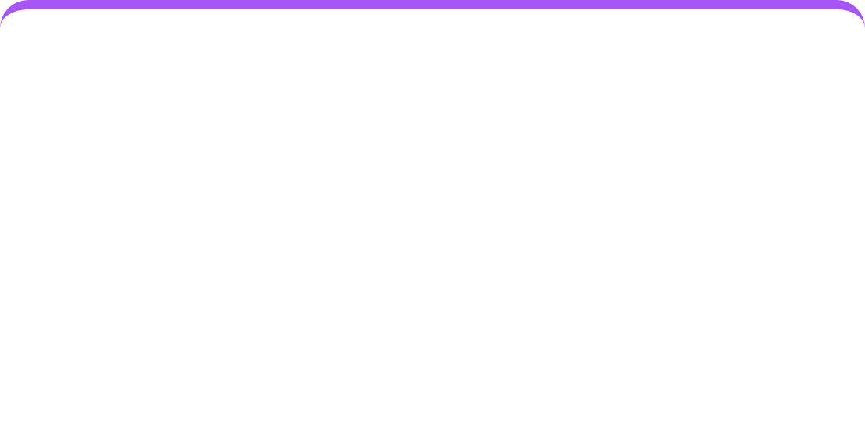
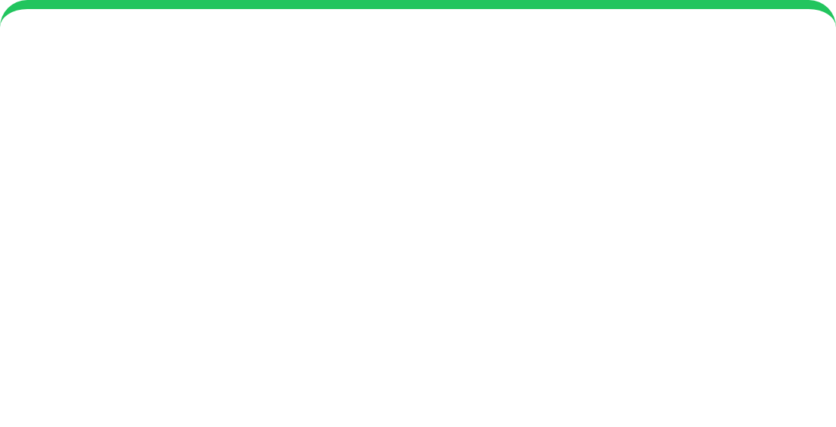







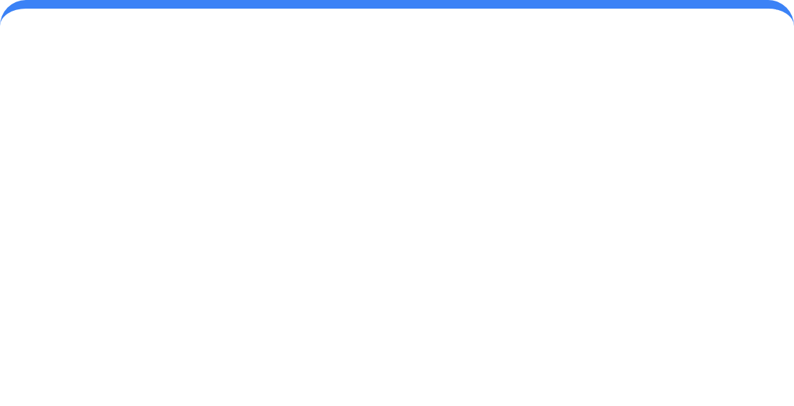








Key Features of MindVideo.ai
MindVideo.ai offers a comprehensive suite of AI-powered features designed specifically for educational video creation:
AI Script Generation
High-Quality Visuals
Human-Like Voiceovers
Automatically generates comprehensive scripts from text prompts, saving significant content creation time.
Provides AI-generated images and video素材 with professional quality that effectively illustrate educational content.
Multiple language and accent options for realistic AI voices that add professionalism to educational videos.
Automatic Subtitles
Intuitive Interface
Rich Template Library
Generates and synchronizes subtitles, improving video accessibility and learning effectiveness.
Simple, accessible design that allows non-video professionals to create high-quality educational content.
Diverse collection of educational video templates to accelerate the production process.
Page 15 of 24

Slide 16











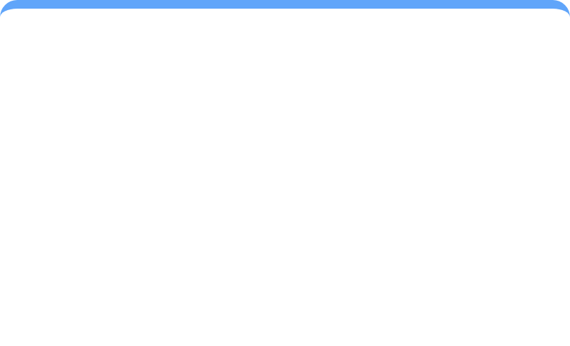


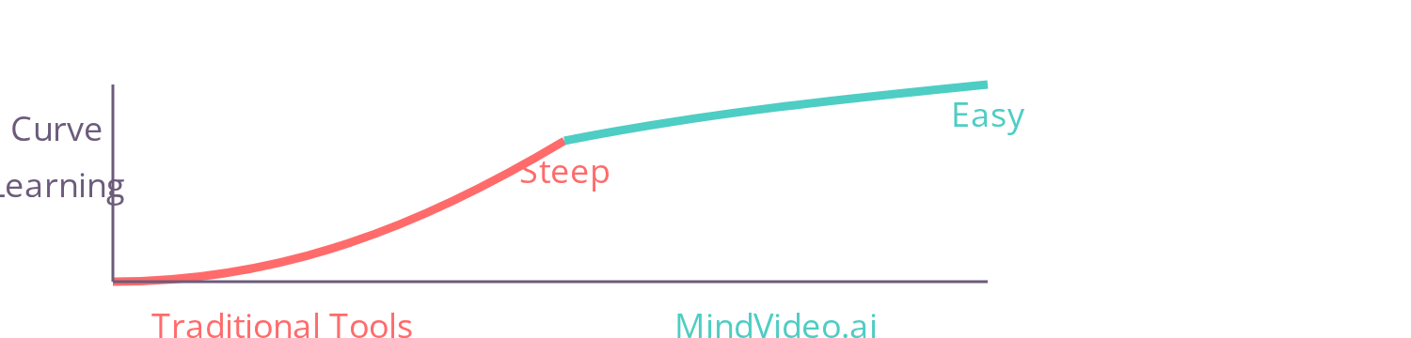
User-Friendly Interface
Intuitive Design
Lowered Learning Curve
Simple, clean interface for easy navigation
Streamlined workflow with clear step-by-step guidance
Quick Learning
Inclusive Team
Accessible controls for all skill levels
New users mastered the platform rapidly
Non-video experts could contribute
"Its friendly interface and powerful automation features allowed team members without professional video backgrounds to create high-quality educational videos."
Increased Productivity
Enhanced Confidence
Faster video creation process
Team felt empowered to create
Page 16 of 24

Slide 17








Overcoming Previous Challenges
MindVideo.ai directly addressed the limitations we encountered with Gemini and free tools, providing a comprehensive solution.
Previous Limitations
Technical Issues
MindVideo.ai Solution
Gemini Limitations
Technical Challenges
Solutions Provided
Not a ready-to-use video tool
Limited video generation capabilities
End-to-end video production
Focus on text and image generation
API constraints for content creation
AI-driven script generation
Rate limits (3 req/min, 10,000 tokens/min)
Complex integration required
High-quality visual effects
Free Tools Limitations
User Experience Issues
Solutions Provided
Functionality restrictions
Steep learning curves
No watermarks (paid plans)
Obtrusive watermarks
Inconsistent performance
Intuitive interface
Poor user experience
Limited customization
Rich template library
Key Advantage: MindVideo.ai simplified our workflow, eliminated technical constraints, and improved video quality.
Page 17 of 24

Slide 18





















Our Streamlined Workflow
1. Prompting
2. Generation
3. Text-Based Editing
4. Customization
5. Publishing
Input video idea as text prompt with details on length, platform, and voiceover accent
AI generates script, visuals, voiceovers, subtitles, and background music
Customize designs and visuals to align with branding and educational objectives
Export high-quality video and share with audience
Edit videos using simple text commands like "delete scene" or "change voiceover"
Key Workflow Benefits
Intuitive & Fast
Accessible
Efficient
Significantly faster than previous attempts
Even non-video experts can create professional videos
Streamlined process from idea to publication
Page 18 of 24

Slide 19












Text-Based Video Editing
Revolutionary Approach
Text-to-Video Editing
MindVideo.ai's text command editing functionality allows users to edit videos using simple text commands, drastically reducing post-production time and complexity.
"Delete scene"
Remove unwanted scenes
Time-Saving Benefits
"Change voiceover"
Modify narration
Eliminates need for complex video editing software
Reduces post-production time by hours
"Adjust accent"
Enables rapid iteration and testing
Change voice accent
"Text-based editing changed everything for our team"
Page 19 of 24

Slide 20
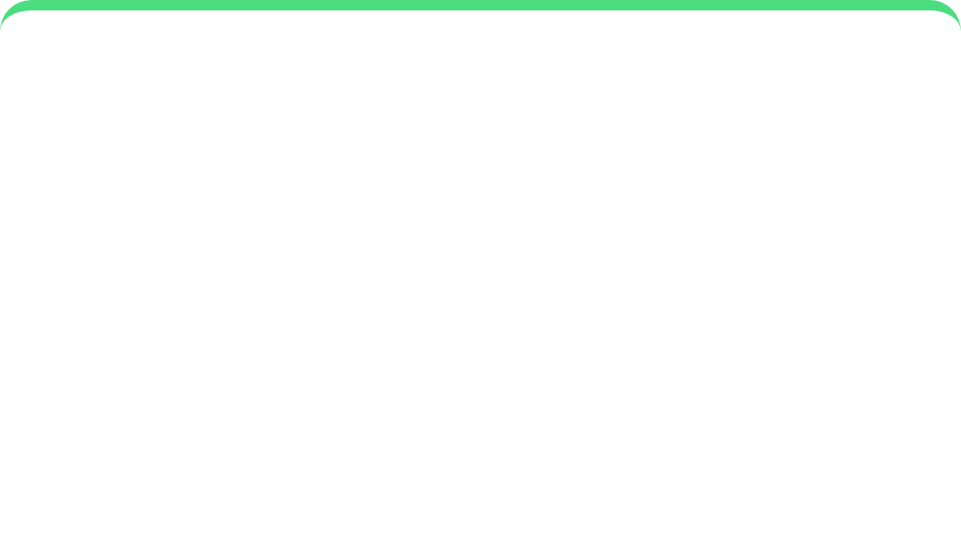

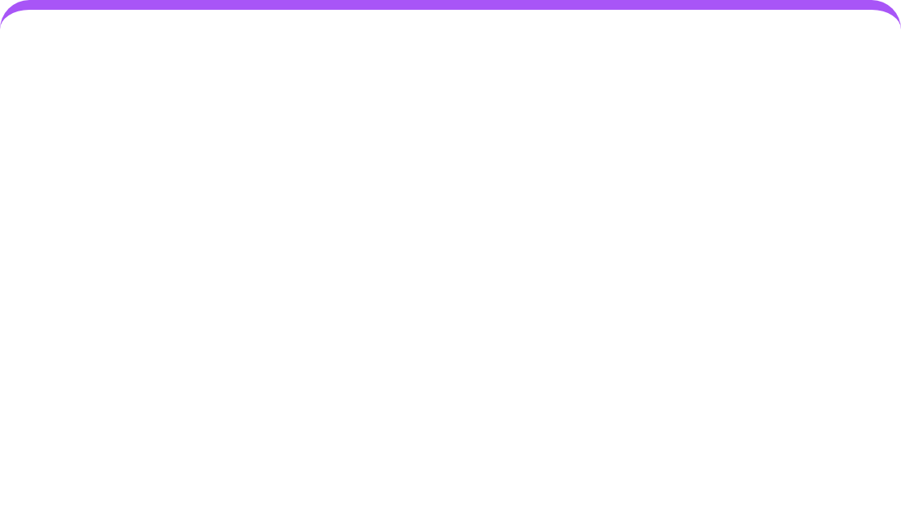






Quality Improvements
MindVideo.ai significantly enhanced our video production quality, creating more effective educational content.
High-Quality Visuals
Realistic Voiceovers
Enhanced Production
Professional AI-generated images
Human-sounding AI voices
Dynamic and memorable content
Relevant visual elements
Multiple language options
Professional presentation
"The videos created with MindVideo.ai elevated our multiple-choice program, making learning more engaging and effective."
Page 20 of 24

Slide 21


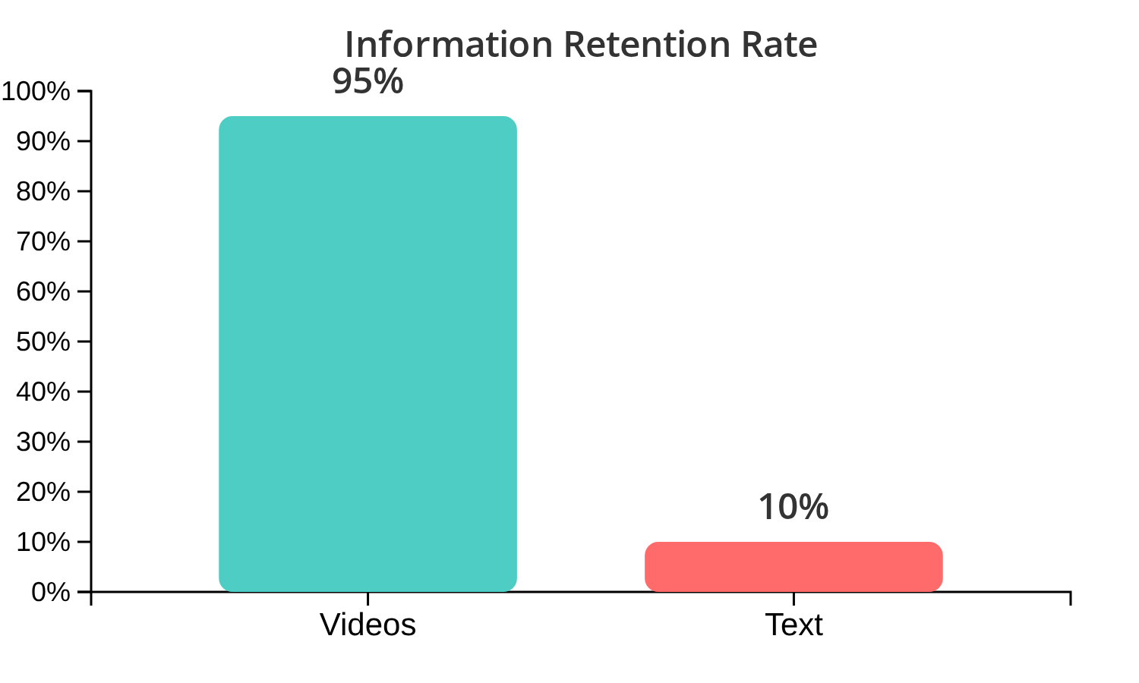







Impact on Student Engagement
Information Retention
Key Observations
Enhanced Comprehension
Videos made learning material more dynamic and memorable
Improved Interaction
More positive reception to educational content
Cognitive Load Reduction
Visual elements helped break down information into digestible segments
"Educational videos leverage the power of visual and auditory learning, making information more accessible and engaging for students."
Source: Invideo AI Study
Page 21 of 24

Slide 22












Key Lessons Learned
Tool Selection is Critical
Thorough Evaluation
The right tool, tailored to specific project needs and user capabilities, is paramount for efficient and high-quality content creation.
Strategic tool evaluation and adoption can streamline workflows and maximize creative output, as demonstrated by our journey.
User Experience Matters
Iteration is Essential
Intuitive interfaces and powerful automation features enable team members without video backgrounds to create professional-quality videos.
Continuous refinement of tools and processes led to significant improvements in video quality and production efficiency.
"The right tool transformed a frustrating endeavor into a successful one."
Page 22 of 24

Slide 23
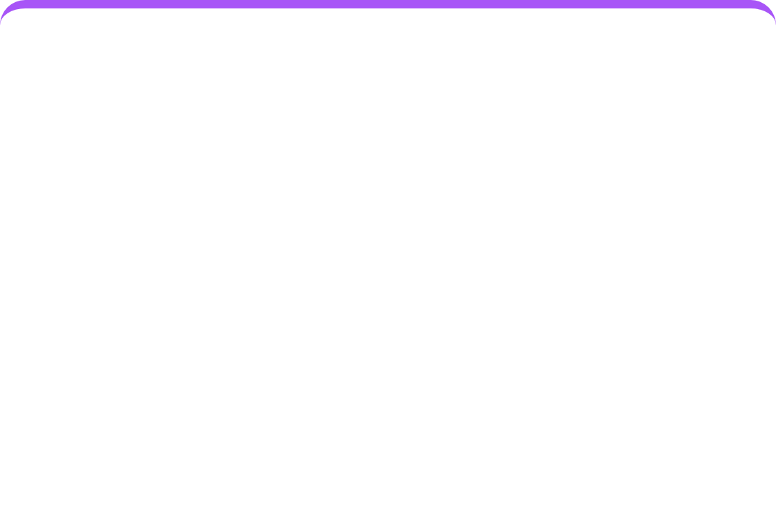
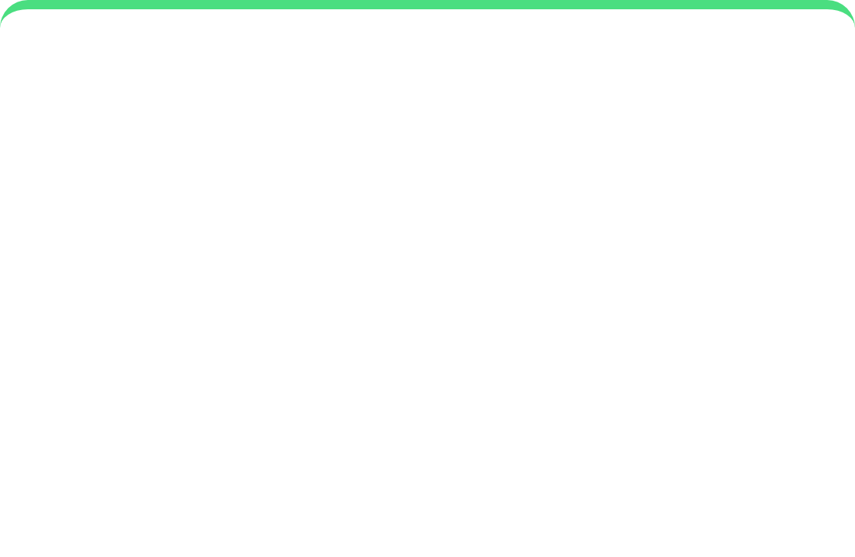




Future Applications
Our experience with MindVideo.ai has shown us the importance of selecting the right tools for content creation. Here's how we'll apply these lessons moving forward:
Enhanced Tool Evaluation
Streamlined Workflows
Expanded Video Integration
We'll conduct more thorough assessments of video tools, focusing on specific project needs and user capabilities.
Implementing the efficient workflow we established with MindVideo.ai across all content creation projects.
Increasing video integration in our educational content based on the positive impact we observed.
"The right tool makes all the difference. Moving forward, we'll prioritize thorough tool evaluation to maximize creative output."
Page 23 of 24

Slide 24










Conclusion: The Right Tool Makes All the Difference
Struggle
Search
Success
Gemini limitations & free tool constraints
Exploring countless options
MindVideo.ai transformation
Key Insights
Tool Selection
Team Empowerment
The right tool transformed our workflow
Non-technical team created professional videos
"The right tool doesn't just improve output—it transforms the entire creative process."
Page 24 of 24

Slide 25
THANK YOU

